Slide 1
Displacement

Slide 2

In this Smart Lesson you will learn to:
Define the term displacement.
Explain what displacement is.
Calculate its magnitude.

Slide 3
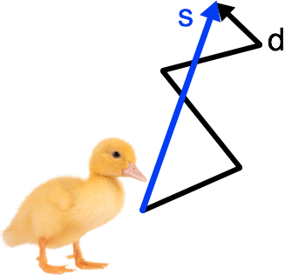
Displacement definition.
Displacement is defined as a vector quantity representing the location of the destination relative to the origin of motion only, irrespective of the path actually taken between the two points.
Displacement (represented by the symbol s) is the shortest distance between an object's starting point and its finishing point.
Imagine a baby duckling that is still learning how to walk. It might wobble around as it walks, creating a zigzag pattern, but the displacement of the duckling is a straight line!

Slide 4

Displacement is a vector.
This means that it has both a size and direction associated with it. We say that the size of the displacement vector is its magnitude.
Displacement is measured in metres (m).

Slide 5
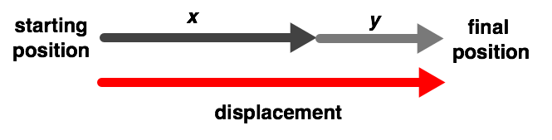
Adding displacement in 1-dimension.
Remember, if an object travels distance x in a certain direction then travels a distance y in the same direction, the displacement is found by adding the two distances.
s=x+y

Slide 6
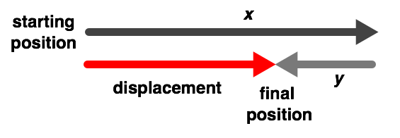
Subtracting displacement in 1-dimension.
Similarly, if an object travels distance x in a certain direction then travels a distance y in the opposite direction, the displacement is found by subtracting the two distances.
s=x−y

Slide 7

But how do we calculate displacement in 2-dimensions?
What happens if an object completely changes direction, instead of just moving back and forward?
The answer lies in a mathematical tool called Pythagoras' Theorem. Let's see how it works!

Slide 8
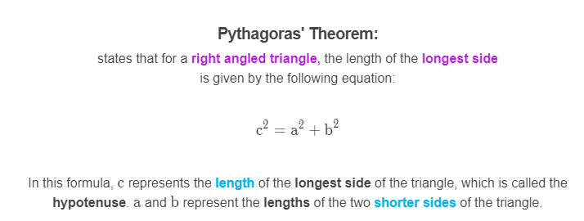
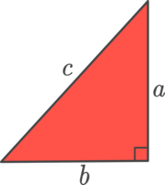

Slide 9
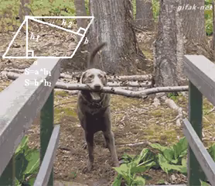
So how does Pythagoras' Theorem help us find the displacement of an object?
Let's work through an example together to find out!

Slide 10

Worked example:
Josie is walking to the school canteen after class. To get there, she needs to walk 3 m north and then turn and walk 4 m east.
What is Josie's displacement after she walked to the canteen?

Slide 11
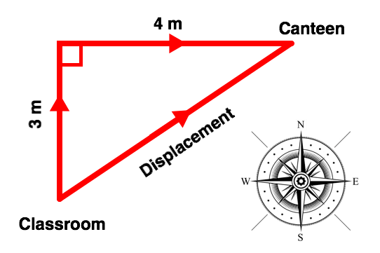
Our first step is to draw a diagram of Josie's motion as she walks to the canteen.
This is pictured below.
We can see from the diagram that Josie's motion forms a right angled triangle, and her displacement is the hypotenuse of the triangle. This means that we can use Pythagoras' Theorem to calculate Josie's displacement.

Slide 12
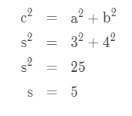
Next, we substitute the values we were given into the equation for Pythagoras' Theorem and solve to find the displacement.
Therefore, the magnitude of Josie's displacement is 5 m.

Slide 13

Well done! You should now be able to use Pythagoras' Theorem to calculate the magnitude of an object's displacement.
However, displacement is a vector, so it has both a magnitude and a direction.
In this section, we will look at how to find the direction that an object's displacement acts in.

Slide 14
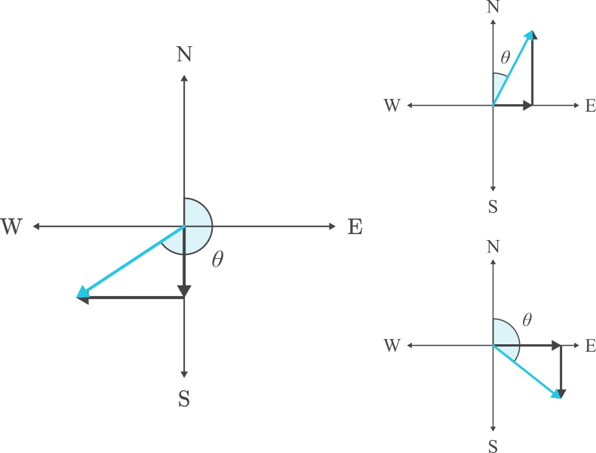
So how can we calculate the direction?
The solution is to make the direction of displacement an angle. Specifically, it is the angle from North to the object's displacement, moving clockwise. This is called the angle of displacement.
Below are some examples of the angle of displacement from North. Note that angles are represented using the Greek letter theta (θ).

Slide 15
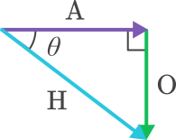
How do we find the angle?
We can find θ using the sides of the triangle. A right-angled triangle has three distinct sides: the hypotenuse, adjacent side and opposite side. This is what the H, A and O in SOH CAH TOA stand for.
The hypotenuse is the longest side of the triangle. The adjacent side is next to the angle θ. The opposite side is opposite the angle θ.
Having trouble remembering which side is which? Remember, the hypotenuse is across from the right-angle. The adjacent side touches the angle being calculated (θ) while the opposite side does not.

Slide 16
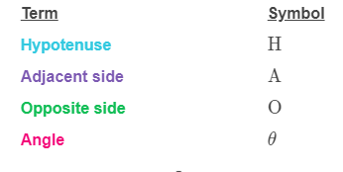
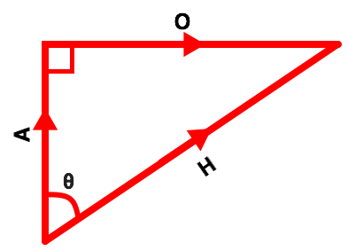
This seems very straightforward!
The names of the sides tell you exactly where they are on the triangle.
However, there is one problem: mathematicians are too lazy to write out "opposite side" or "hypotenuse" every time they calculate the angle of a triangle. Instead, they use symbols to represent the sides. These symbols are shown in the table below:

Slide 17
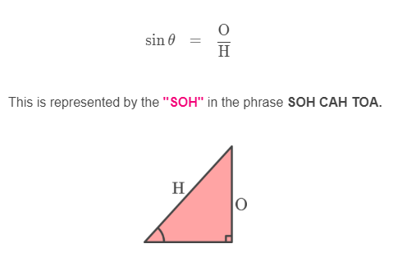
There are a couple of trigonometric functions that we need to use in SOH CAH TOA.
These are sine, cosine and tangent.
We find the sine of an angle by dividing the opposite side by the hypotenuse.

Slide 18
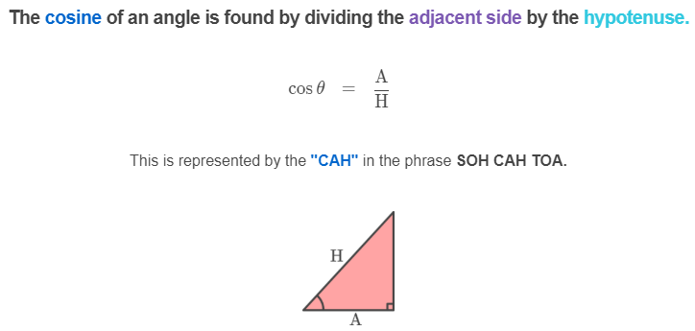

Slide 19
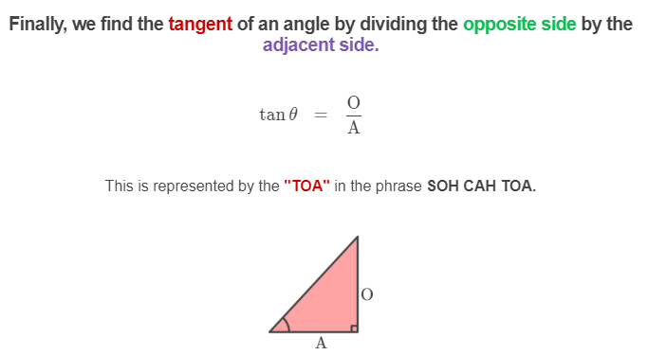

Slide 20
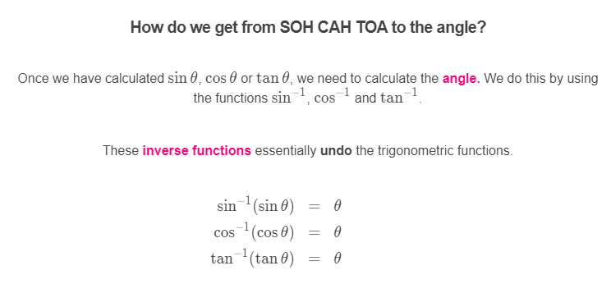

Slide 21
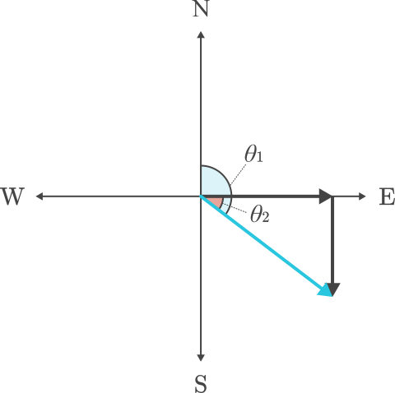
Finding direction.
Now that we know how to use SOH CAH TOA to find the angle inside a triangle (θ₂​), we can finally find the angle of displacement (θ₁​). Remember, this is the angle between north and the object's displacement when moving clockwise.

Slide 22
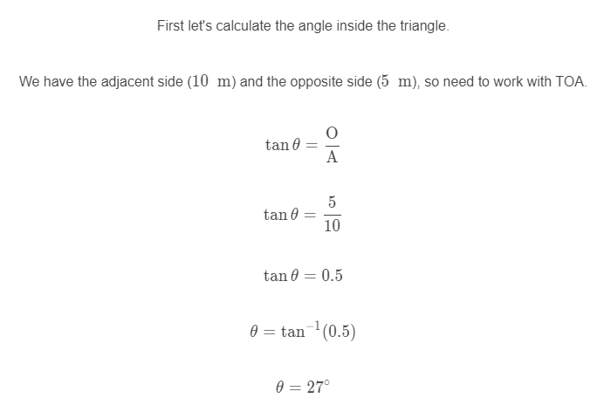
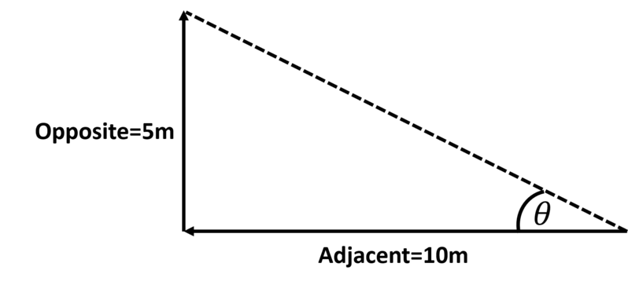
Let's look at an example.
An object moves west 10 m, then north 5 m, producing the triangle seen below. We want to find the angle of displacement (θ).

Slide 23
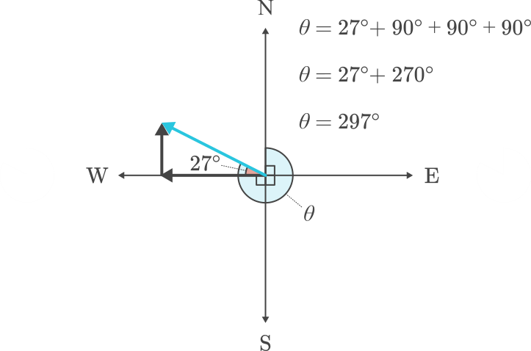
How does this give us the direction?
If we already know the angle inside the triangle is 27∘. We also know that the angle between each compass direction is 90∘. So it is 90∘ from north to east, another 90∘ from east to south and another 90∘ from south to west. All we need to do is add these angles up to find θ.

